Slide 1
WAP in C++ to determine force using:
Force = mass * acceleration
WAP in C++ to pressure using:
Pressure = Force/Area

Slide 2
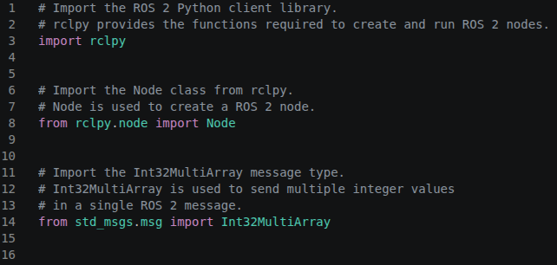
WAP in C++ to add and subtract two numbers

Slide 3
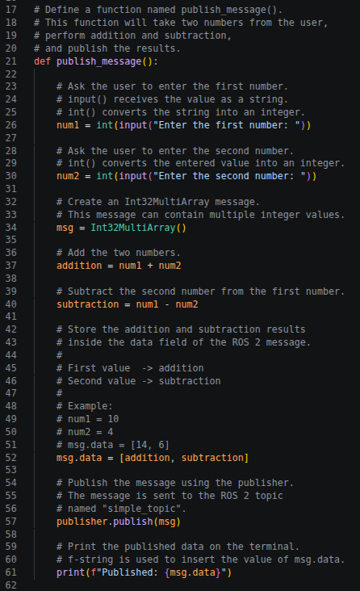
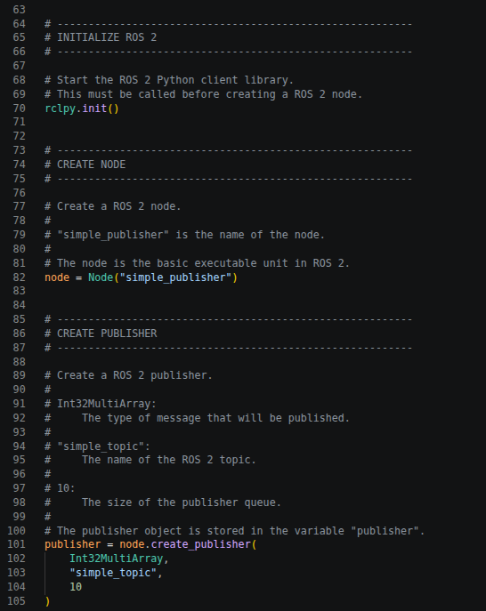

Slide 4
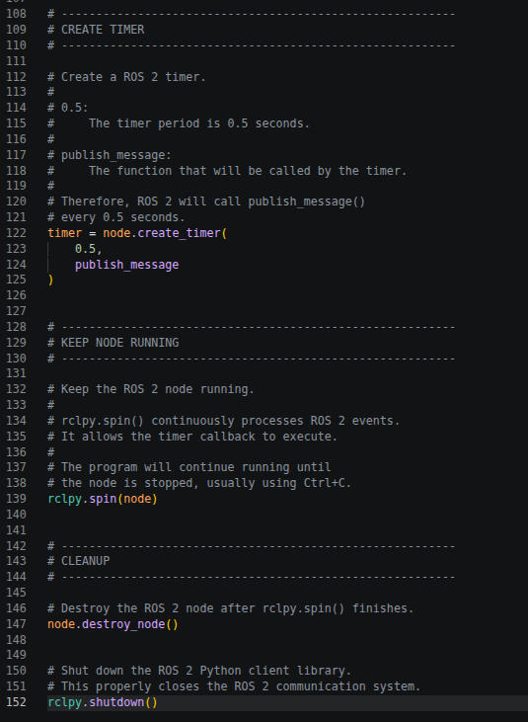

Slide 5
For example:
Enter the first number: 20
Enter the second number: 5
Addition = 25
Subtraction = 15
Published: [25, 15]
Then another ROS 2 node can subscribe to /simple_topic and receive [25, 15].

Slide 6
WAP in C++ to subscribe added and subtracted numbers and multiply them
/simple_topic
↓
[25, 15]
↓
addition = msg.data[0] = 25
subtraction = msg.data[1] = 15
↓
multiplication = 25 × 15
↓
375

Slide 7
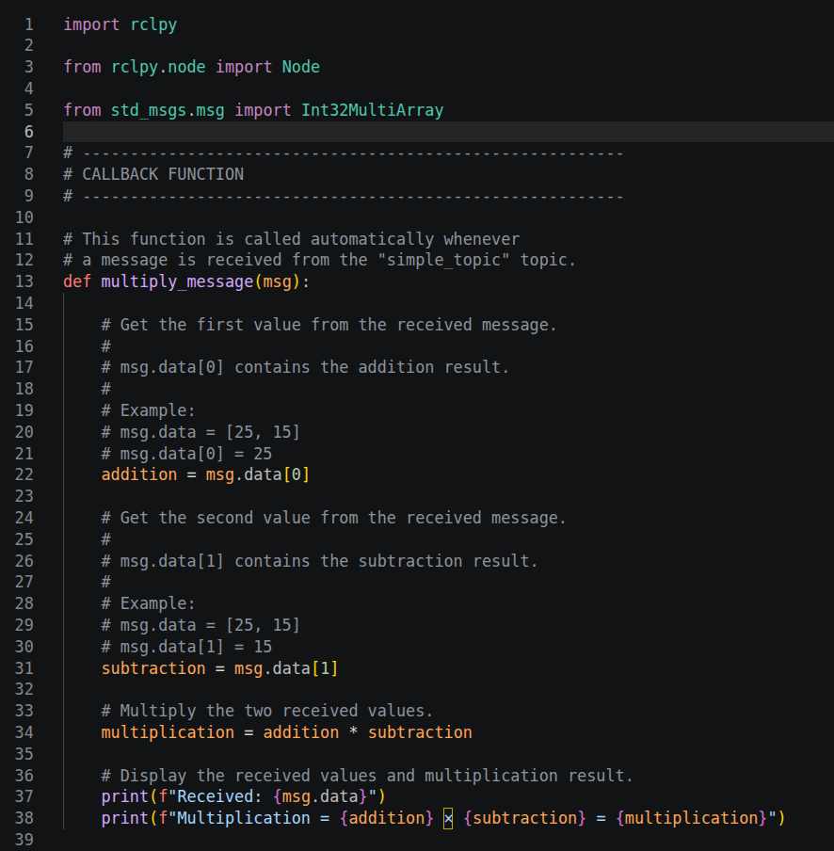
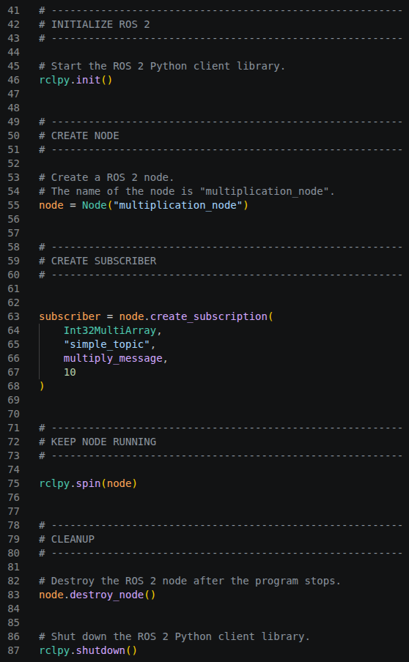

Slide 8
Develop a ROS 2 Python program to calculate the acceleration, force, and torque of a moving robot using publisher and subscriber nodes.
The system should contain three nodes:
Acceleration Publisher
Take initial velocity u, final velocity v, and time t.
Calculate acceleration using:
a = (v - u) / t
Publish the calculated acceleration on the /acceleration topic.
Force Subscriber
Subscribe to /acceleration.
Assume a given robot mass m.
Calculate force using:
F = ma
Publish the calculated force on the /force topic.
Torque Subscriber
Subscribe to /force.
Assume a given wheel radius r.
Calculate wheel torque using:
Torque = Fr
Display the calculated torque in Nm.

Slide 10
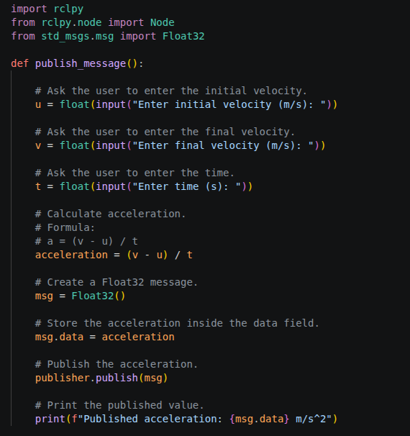
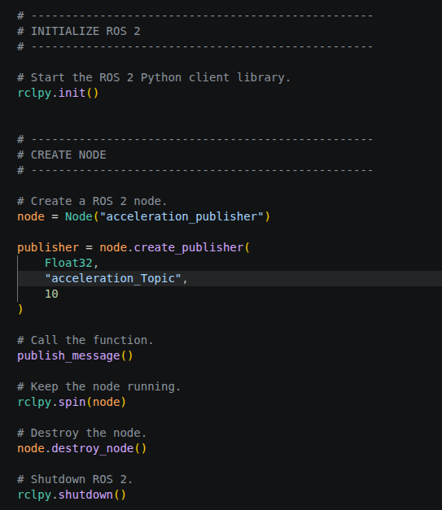

Slide 11
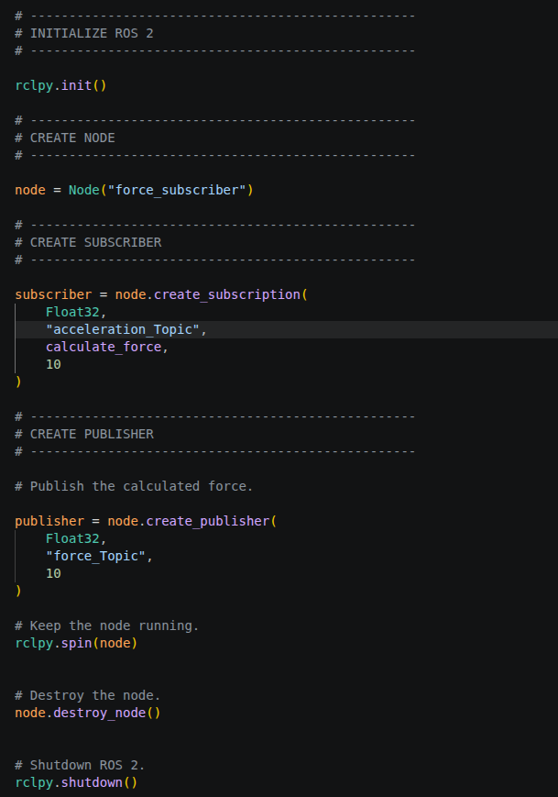
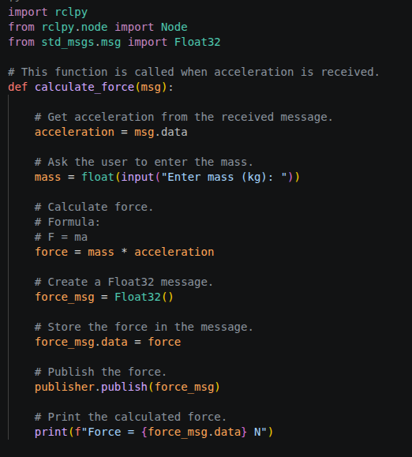

Slide 12
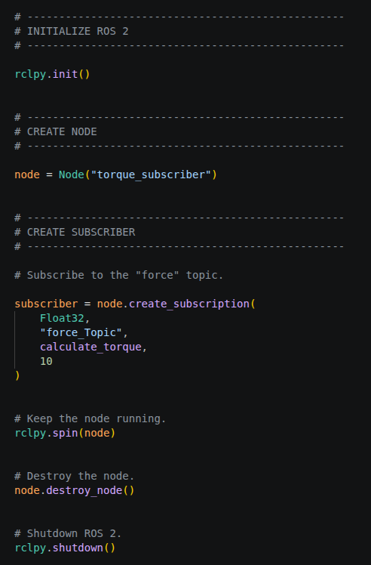
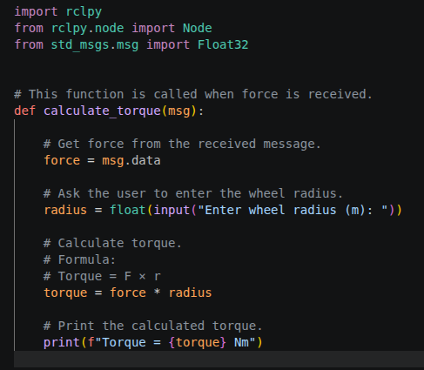

Slide 13
Develop a ROS 2 Python program to calculate the distance travelled, velocity, force, and work done by a mobile robot using publisher and subscriber nodes.
The system should contain three nodes:
1. Distance Publisher
Take the initial position x_0, final position x, and time t.
Calculate distance:
d = x - x_0
Calculate velocity:
v=d/t
Publish the calculated velocity on the /velocity topic.
2. Force Subscriber
Subscribe to /velocity.
Take the previous velocity v_p and time interval Δt.
Calculate acceleration:
a = (v - v_p)/ Δt
Assume a given robot mass mm.
Calculate force:
F = ma
Publish the calculated force on the /force topic.
3. Work Done Subscriber
Subscribe to /force.
Take the distance travelled d.
Calculate work done using:
W = Fd
Display the calculated work done in Joules (J).

